Slide 1
Pantry Pal
DB schema and SQL queries

Slide 2

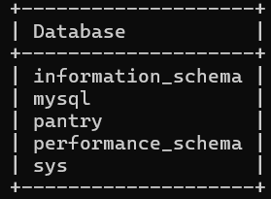
DDL
Query
DataBase

Slide 3


Query
DataBase

Slide 4


Query
DataBase

Slide 5
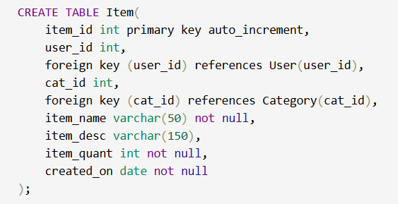

Query
DataBase

Slide 6
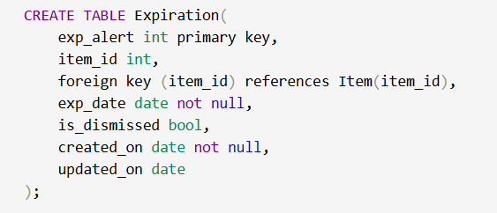

Query
DataBase

Slide 7

DML
CREATE:

Slide 8


READ
Query:
Output:

Slide 9


UPDATE
Query:
Updated Table:

Slide 10


DELETE
Query:
Updated Table:

